Slide 1
GRAD 2025 PARENT MEETING

Slide 2

TICKET PRICES:
Grad Dinner $100.00
Safe Grad- $75.00
The link to order tickets can be found in the Grad Information Package and on the school website (Grad Infor) starting on April 15, 2025.
  Dinner and Safe Grad Registration including payment are to be completed online (by credit card)
  Option to pay in person
  Due by Friday May 30th.

Slide 3
2025 Grad COMMITTEE
Tess Bernacki Grad Chair
Janice Compton & Fran Yadao, Communications co-chairs
Jill Heater & Jen Kennedy-Busch, Entertainment co-chairs
Michelyn Wood & Chantelle Maksymetz, Safety co-chairs
Daryla Christie & Day Scarlett, Food and Decor co-chairs
Jen Chan & Katheen Hayton, Medical co-chairs
Tracy Bowman, Incoming Grad Chair 2026
Kate Brito, Office of the President, School Representative

Slide 4
Graduation DINNER
Friday, June 20, 2025
RBC Convention Centre
North Building
  Registration will begin at 5:00PM.
  Cash bar will be open at 5:00PM.
  Dinner and festivities to begin at 6:00PM.
  Graduands and their guests whose ID have been verified to be 18+ will receive an “Age Verified” wristband.
  Graduands and their guests must have a government-issued form of ID with them at all times at both the dinner and Safe Grad.
  Photographs of ID is not an acceptable form of identification.

Slide 5
SAFE GRAD CHECK-IN
  Safe Grad takes place immediately following the Grad Dinner in the same event space.
  All attendees will be asked to leave the ballroom immediately following dinner to allow event staff to prepare the room for Safe Grad.
  One parent will be required to check their son and guest back into Safe Grad.
  Only parent volunteers will be permitted into the Safe Grad space.

Slide 6
SAFE GRAD CHECK-IN
  Grads and their guests will be required to hand in their cell phones when they check in to Safe Grad. Cell phones will be returned at check-out.
  Grads and their guests must remain in their formal attire for the entire evening. “Dressing down” is not permitted.
  Grads and their guests are not permitted to leave the Convention Centre between the Grad Dinner and the Safe Grad portion of the evening.

Slide 7
SAFE GRAD FUN 9:30PM-2AM
  Complimentary food items and non-alcoholic beverages will be available at Safe Grad.
  Alcohol will be available to purchase at Safe Grad.
  Only graduands and their guests aged 18+ wearing “Age Verified” wristbands will be allowed to purchase and consume alcohol at Safe Grad.
  Various activities, prizes and games will be available at Safe Grad, including a DJ, dance floor and casino.
  We are planning a FUN, SAFE evening for our young graduands.

Slide 8
SAFE GRAD PICK up
  Safe Grad will be over at 2:00AM. Graduands and guests must be picked up by 2:30AM.
  Graduands and their guests must be checked out by the individual identified on the driver release form at the safety check-out desk locate in front of Safe Grad.
  Drivers must bring photo ID to verify their identity, no exceptions.
  Parent Volunteers can take their graduands and guests home safely and get some much-deserved sleep.

Slide 9
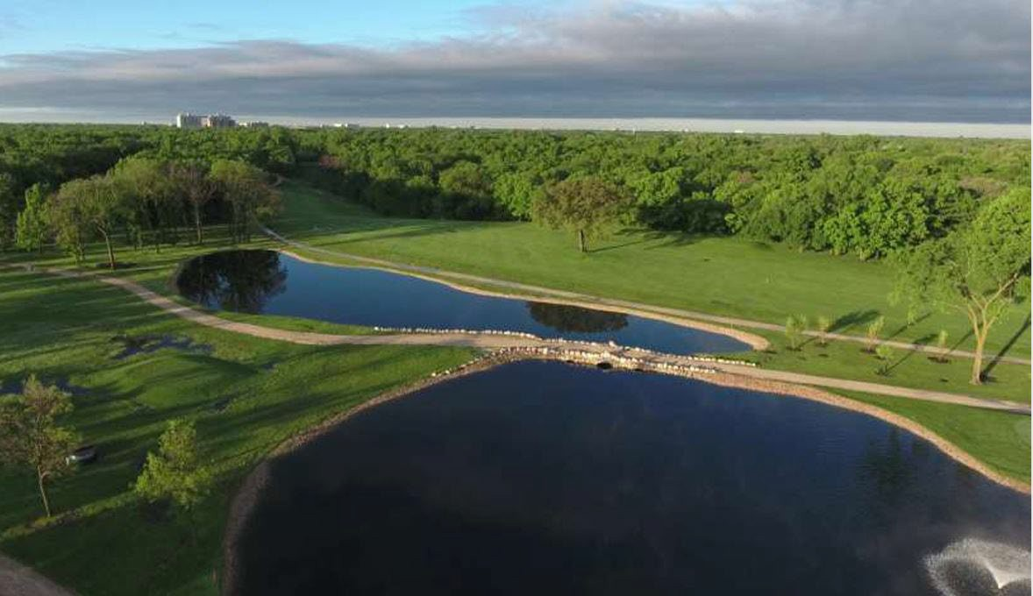







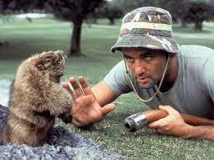



2025 Ernie Osterman Graduand Golf Tournament
Bridges Golf Course
Wednesday, June 25/2025
1:00 PM Shotgun Start
BBQ lunch and Dinner included
Participant Gift Bag.
Full details in your information package

Slide 10

Registration Opens: April 25th
Open to all Graduands and their mentor
Register in Groups of 4 – 2 Students 2 Mentors
144 player’s max
Reservations on first come first serve basis
  Through the online registration link (payable by credit card)
  Cash or Cheque Payable to SPHS; Drop off Form at President’s office (Kate Brito)
11:00 am Registration starts.
11:30 am BBQ lunch starts
1:00 pm Shotgun Start
6:00 pm – 8:00 pm Dinner

Slide 11
Registration Opens: April 25th
Cost: $185.00 per player
Dinner Only $60.00
$20.00 Get’s you Putting contest, Beverage, 1 Mulligan.
Club Rentals are available for $50.00 (Limited availability)
If you are renting clubs, please contact the golf course directly to arrange.
If there are cost concerns, your son can speak to his counsellor.
Registration Deadline is Friday June 6th!

Slide 12
Volunteers &
Sponsorships
Volunteers
Sponsorships
2 volunteers to coordinate prize donations, and Sponsorship.
Helps to defray costs
Tournament run on a cost neutral basis
Approximately 6 volunteers needed for day of event. Lunch Provided
- Registration Table (2)
- Prize set up (2)
- Course Concierge / Photo’s (2)
Indicate on sign-up form.
If staying for dinner: Cost is
$60.00
Grade 12 Students also welcome to volunteer!
Seeking hole Sponsors Recognition Signage Included
- Hole in one 4 Available
- Long Drive 3 Available
- Closest to pin 4 Available
- Closest to the line 1 Available
Prize Donations (in set of 4)
If you wish to donate an item for the graduand gift bags - will need 72
Hole Sponsor: $ 350
Prize/Sponsorship Donations
Contact:
•
•
Mark Carver 204-330-4910
Jay Storozuk 204-990-7869

Slide 13
We Need PARENT VOLUNTEERS!
  SignUp.com
  The link may also be found on the Grad Info page on the school website starting on April 15, 2025.
  Thank you for volunteering!

Slide 14
CLOSING REMINDERS
  The Grad Information Package, which includes the registration links for ticket orders and the information for the Ernie Ostermann ‘57 Graduand Golf Tournament, will be sent to families on Tuesday April 15th.
  This will also be posted on the Grad Info page on the school website.
  Due date for Grad Dinner and Safe Grad ticket orders is Friday May 30th.
  Ernie Ostermann ‘57 Graduand Golf Tournament Registration opens Friday April 25th, and closes on Friday June 6th.

Slide 15
Thank you

